Slide 1
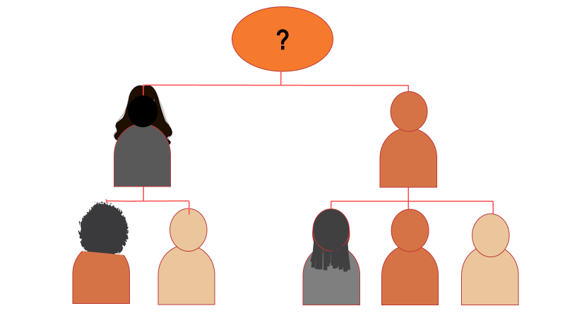
Succession Planning: “More Vital than Ever”
Wednesday, June 15, 2022

Slide 2



BEFORE WE BEGIN
Q&A
Chat
You are muted upon entry into the webinar
Click the Q&A icon to submit your questions anytime.
Use chat for comments or to elaborate on surveys
Grantee attendance
survey is linked in chat
We will send you the PPT & recording
2

Slide 3
Webinar Agenda
Introduction
2. Scope/Focus: Importance of Succession Planning
3. Types of Executive Transitions
4. Building Bench Strength
5. Emergency/Unexpected Transitions
6. Scheduled-Departure Transitions
7. Ongoing Role for the Former Chief Executive
8. Q&A

Slide 4
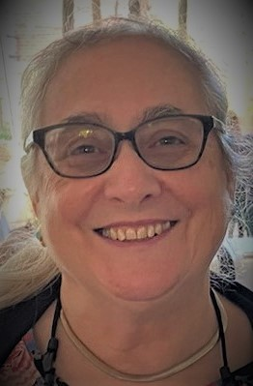
MEET OUR PRESENTERS
Emily Gantz McKay
President/Managing Director
EGM Consulting, LLC
Washington, DC
17 years as founding President/CEO of technical assistance provider Mosaica: The Center for Nonprofit Development and Pluralism
16 years on the senior staff of what is now UnidosUS
Consultant to the Hispanic Federation since 1996
Has assisted both small and large nonprofits with transition planning and hiring of new chief executives – as a consultant and as a Board member
BA and MA in Communication from Stanford University

Slide 5
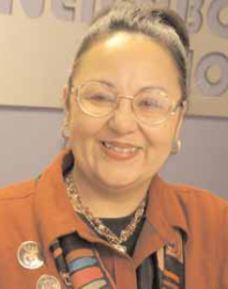
MEET OUR PRESENTERS
Evelyn Laureano, Ph.D., LMSW
Former President/CEO
Neighborhood Self Help by Older Persons Project (SHOPP), Bronx, NY
Long-time President/CEO of SHOPP, retiring in 2018
Continues to assist SHOPP
Currently teaching social work in aging courses at CUNY’s Lehman College
Developed strengths-based social work practice models with minority elders
Established first elder abuse intervention program in the Bronx
Divides her time between New York and Puerto Rico
MSW from Hunter College, Ph.D. from Yeshiva University

Slide 6
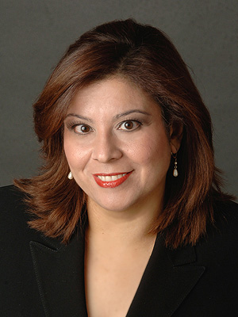
MEET OUR PRESENTERS
Lillian Rodriguez Lopez
Consultant
Atlanta, GA
President/CEO of Hispanic Federation from 2004-2012
Currently a consultant to the Hispanic Federation and other corporate and nonprofit clients
Former Vice President, Stakeholder Relations and Consumer Public Affairs for The Coca-Cola Company
Board Chair of Latino Community Fund Georgia
Board member of the National Puerto Rican Day Parade
BA in Communications from Fordham University

Slide 7

Webinar Scope and Focus
Succession planning means preparing for leadership transition within your nonprofit – to ensure leadership continuity
  Transition can include Board, chief executive, or other senior positions
This webinar will focus on planning for the succession of the chief executive
  Expected or unexpected
  Immediate or in a year or more

Slide 8
Experience with Executive Transitions
Poll #1
What types of executive transitions/successions have you experienced or closely observed? Check all that apply.
No experience
The scheduled departure of the founding chief executive
The scheduled departure of a chief executive who was not the founder
A temporary emergency transition – executive returned
A permanent emergency or unexpected transition
Termination/firing of a chief executive
Development of internal staff for possible promotion to chief executive

Slide 9

Importance of the Board’s Role in Transitions
Hiring – and keeping – the right leader is one of a nonprofit Board’s most important responsibilities
The Board should play the lead role in chief executive transitions
A good succession plan helps the Board bring in a qualified leader who “fits” the organization and will help it move forward successfully

Slide 10

Executive Turnover: An Increasing Trend
In 2020, according to CompassPoint (Daring to Lead):
1 in 6 nonprofit executives planned to leave their job within 2 years [That means 2022!]
Only 1 in 6 of 3,000 U.S. nonprofits surveyed had a succession plan
In 2021, according to BoardSource (Leading with Intent),
Almost 3/4 of nonprofit chief executives were working without an employment contract

Slide 11

Nonprofit Executive Turnover, cont.
In 2022, according to the Chronicle of Philanthropy:
  “Large Numbers of Nonprofit Leaders Are Stepping Down — and the Competition to Find New Ones Is ‘Fierce’” [May 2022]
  Nonprofit associations in NY, NJ, and CA see increased leadership turnover
  Leaders – including founders – who delayed retirement during the pandemic are leaving now
  More mainstream nonprofits are recruiting leaders of color
Increased competition means nonprofits in transition may need to:
  Increase salaries and benefits
  Prepare for a longer recruitment period
  Increase use of Acting or Interim executives

Slide 12
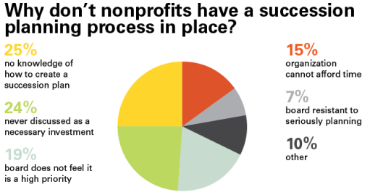
Source: Georgia Association of Nonprofits, 2013

Slide 13
Executive Transitions in Your Nonprofit
Poll #2
How long has it been since your nonprofit has had a chief executive transition? Check one.
About to begin or in the middle of one now
Less than a year
1-3 years
4-6 years
7-10 years
More than 10 years
Never – our founding chief executive still runs the organization

Slide 14

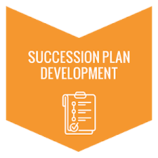


Types of Succession Planning
Strategic Leader Emergency Scheduled-Departure
Development or Unexpected or Planned
Transition Succession

Slide 15
Three Types of Succession Planning
Type | Explanation
Strategic Leader Development: Building Bench Strength | Planned Prepares 1 or more current staff for chief executive role Requires professional development/mentoring opportunities, internal and external
Emergency or Unexpected Succession | Unpredicted May be short-term, long-term, or permanent Requires an Acting or Interim Director Plan needed “just in case”
Scheduled-Departure or Planned Succession | Policy and process can be planned and ready Requires preparations similar to emergency successions, but with less urgency Lead time varies; ideally 12 months or more

Slide 16
Transition Planning by Your Board of Directors
Poll #3
What succession planning has your Board of Directors done? Check all that apply.
Board has an emergency succession plan
Board has a succession plan for the scheduled departure of a chief executive
Some policies in place but not a full succession plan
No plan, but our Board is good at stepping up when needed
Preparation of 1 or more senior staff to become chief executive
No preparations or plans

Slide 17

Not Just a Plan:
What Makes a Nonprofit Succession-Ready?
Defined culture & clearly stated values
An HR system that supports professional development, recruitment and hiring, onboarding, and personnel evaluation
Ongoing focus on professional development, mentoring, and cross-training
A shared drive or cloud storage for key documents
Regularly updated document and information inventories, contacts list, and key links and passwords
Regular engagement of Board with senior managers
Up-to-date job description for the current chief executive
An identified person who could immediately take on an Acting Director role in an emergency – senior staff, Board member, or external person
A special fund to cover possible extra expenses if needed
A current, active strategic plan

Slide 18

Information Checklists for Succession Planning
Vital information inventory
  Nonprofit status
  Financial information
Key financial information
  Banking Information and authorized check signers
  Investments information and who is authorized to make transfers
  Document security and who has the key or combination
Legal information
  Legal Counsel or advisor and any pending legal matters
Human Resources: HR & payroll information
Facilities
  Lease or deed
  Building management
  Office security system and passcode
Grants and contracts: current & pending
Insurance: all types, with policy numbers & contacts
Fundraising
  Top donors and pending actions
  Pending requests
  - Third Sector Company

Slide 19
Research: External Hiring Increases Risk
External recruitment vs. hiring from within
Most nonprofits usually hire externally
Only 30% of nonprofits fill C-suite roles with internal candidates (compared to about 60% of for-profit corporations)
Only 20% of externally hired executives are seen as “high performers” after 1 year
Most frequent reason given for failure: “poor culture fit” – “they just don’t work well with the people on their teams” due to a mismatch in workstyle and priorities and “inability to tap into informal and formal sources of organizational power”
− Harvard Business Review

Slide 20

Building Bench Strength
Discuss benefits of preparing current staff for leadership
  Hiring from within has higher success than external hiring
  An internal hire reduces transition time and “opportunity costs”
Develop more than one potential successor
Start soon after the last transition!
Support development of internal talent by providing:
  Regular performance feedback and appraisals
  Ongoing professional development for all staff
  Individualized plans for senior management staff
  Mentoring opportunities
  Cross-training
  Deliberate opportunities for managers to use new skills

Slide 21

Sharing Experiences: Building Bench Strength and Hiring from Within
Example: Hispanic Federation: 5 chief executives in its 32 years; the last 3 have been internal hires
Benefits of preparing a
successor from within?
What is required?
Challenges?
Why has it worked for HF?
Lessons learned?
Photo: Association of Latino Professionals for America
(ALPFA)

Slide 22
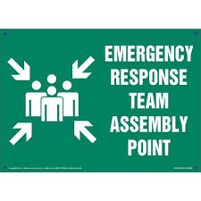
Emergency Succession Plan
Provides leadership continuity through an Acting or Interim executive
Identifies a transition team with clear roles for Board and staff
Includes both a short-term plan and a timeline for permanent succession (if needed)
Addresses security issues and signatories – financial, legal, HR
Provides a communications plan and contact list for outreach to key stakeholders, including funders, allies, clients, and community
Is ready for implementation within 24 hours
Links to a broader plan to hire, onboard & support a new executive
Links to ongoing efforts to build “bench strength”

Slide 23

Priorities for the First 48 Hours
Day 1:
Ensure leadership continuity by naming an immediate Acting Director
Identify any potential crises or pending tasks/deadlines
Establish a Board Transition Team
Communicate situation and immediate plans internally
Day 2:
Provide duties and priorities for the Acting Director
Agree on temporary added/changed roles for other staff
Review and address security issues and signatories
Communicate plans to external stakeholders, in priority order

Slide 24

When the Board Creates the Transition: Terminating a Chief Executive
Understand and follow legal requirements, employment contract provisions or personnel policies -- consult a lawyer expert in HR to minimize risk and bad feelings
Pay special attention to:
  Choice of an Acting or Interim Director
  Communications that provide transparency, for both internal and external stakeholders -- talk to staff, then funders, key allies, other stakeholders
  Possible termination agreement
  Protection of documents and passwords
Be sure all legal questions are addressed before termination
Take the high road in announcements & treatment of the departing executive
Be ready to implement your Emergency Succession Plan

Slide 25

An Acting vs. an Interim Director
Acting Director
Current staff member(s) assuming the chief executive role during the transition
Benefits
  Ensures that someone is in charge
  Because person knows the nonprofit, may provide continuity and minimize disruption
  Low-cost – can free up funds for a transition consultant
Disadvantages/Risks
  May not be an appropriate person on staff
  Selection can create conflict
  You will be short one staff person
Interim Director
A temporary employee or contractor, hired from outside, often a former nonprofit chief executive
Benefits
  Reduces pressure to find a new executive very quickly
  Provides objectivity to assess needs and challenges
  Can help build organizational capacity
Disadvantages/Risks
  Limited knowledge of the organization and sometimes limited knowledge of its work
  Can be expensive

Slide 26

Sharing Experiences: Emergency/Unexpected Transitions
Examples: Illness or death of chief executive or sudden departure for another job or a new experience
Situations?
Temporary or permanent
absence?
Plan in place or not?
Acting or Interim Director?
Key lessons?
Notes:
.

Slide 27

Scheduled-Departure Succession Planning
Allows time for organizational assessment
Requires the same information, inventories, contact lists and communications plans as emergency transitions – but with more time to prepare and implement
Process may take well over a year from old executive’s announcement to full integration or the new executive – especially if there is no strong internal candidate
Enables the Board to consider new directions
Demands additional time and energy from
both Board and staff

Slide 28
Planned Executive Transition: A Five-Part Process
Develop
Transition
Plan
Recruit New Executive
Interview and Hire New Executive
“Onboard” New Executive
Support and Monitor New Executive
6-9 months 3-6 months 3 months 3 months 6-9 months
Total: 21 – 30 months

Slide 29


Who should be involved?
Board of Directors
Search or Transition Committee
Consultant or search firm
Current chief executive (where feasible)
Senior staff
Other staff
Clients and community
Other stakeholders (funders, allies)

Slide 30

Key Board Decisions and Roles
Roles:
Guide the transition
Manage communications, internal and external
Key Considerations and Decisions:
Job description and compensation for new executive
Likelihood of hiring from within
Whether to undertake a broad search/recruitment effort
Need for a consultant or a search firm
How best to involve the departing executive – and what if any ongoing relationship to arrange
How to engage other staff, clients, and other stakeholders
What to do if recruitment takes longer than planned and an Acting or Interim Director is needed

Slide 31
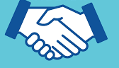
Outgoing Executive Can Ease a Planned Transition
Remember: Founder’s Syndrome applies to long-term executives even if they aren’t the founder!
Prepare the organization to outlast you
Build bench strength at all levels
Maintain a strong, collaborative management team
Help recruit Board members with transition experience
Support but do not lead the transition process
Pass the baton publicly and visibly – internally & externally
Help staff commit to the new executive’s success
Insist that your successor help decide on your new role, if any
Show respect and deference to the new executive
Do not join the Board – at least not for several years, with cautions

Slide 32

Sharing Experience: Scheduled Executive Transitions
Example: SHOPP
Timing?
Board leadership and role?
Use of consultant or search firm?
Lessons learned?

Slide 33
The Transition Doesn’t End with Hiring
Beware of: “We’re glad you’re here. Here are the keys and the passwords. See you at our next Board meeting in two months.”
Board needs to provide “robust onboarding,” support, and active supervision for the new chief executive
Key staff need to support and assist
Board and new chief executive should agree on:
  Strategic priorities for the first year
  Roles and mutual expectations of Board and chief executive
  Objectives and performance measures
  Procedures and timing for monthly, then quarterly, check-ins
  An “emergency contact” to call any time
  Process for annual performance evaluation

Slide 34

How the New Chief Executive Can Maximize Success
Establish your own credibility – look for some quick successes
Insist on clear performance objectives and regular reviews
Build a good working relationship with the Board Chair
Respect and honor your predecessor, especially if the founder or a long-time leader
Build strong working relationships with staff, especially your management team – consider a team retreat
Get to know funders and key allies as soon as possible
Recruit some new board members
Once you feel fully onboard, do strategic planning

Slide 35

Countering the “Clean Break” Myth
“Nonprofits benefit when they carefully plan an extended role for
founders who step down”
Far more nonprofit boards work out a continuing role for founders (45%) than pursue an amicable clean break (31%)
The most successful transition model paired a founder in a continuing role with a successor from inside the organization [also true for long-time executives who were not founders]
Transition work requires preparation and is not easy – the Board needs to help the founder define an appropriate role and shepherd the process
-- Bridgespan Group

Slide 36
Sharing Experience: Roles of a Former Leader
Dr. Laureano continues to assist SHOPP, more than 3 years after her transition
Ms. Rodriguez Lopez has become a consultant to HF
Questions:
  What roles do you play?
  How do you interact with the current CEO?
  What if anything do you avoid?
  Why does it work?

Slide 37

Sum Up
Many nonprofits will face transitions in the next few years
Three key needs:
  Strategic leadership development to provide internal options
  A policy and detailed plan for emergency transition
  A policy and time-phased plan for scheduled-departure transitions
Board leads the transition process
May need: external Interim Director, transition consultant, search firm
New executive needs robust onboarding, clear objectives, regular review and support
Founder’s Syndrome is real, but many nonprofits benefit from continued involvement of the former chief executive
Many useful tools and templates exist

Slide 38

Materials
PowerPoint
Bibliography
Tools:
  Model Succession Policy
  Professional Development Format
HF will send materials to all registered participants
PowerPoint, materials, and video recording will be posted on the HF website

Slide 39

Questions?
Click the Q&A icon to type in your questions!
Q&A
39

Slide 40

Thank You!
55 Exchange Place • Fifth Floor • New York, NY 10005 • (212) 233-8955 • www.HispanicFederation.org

