Slide 1
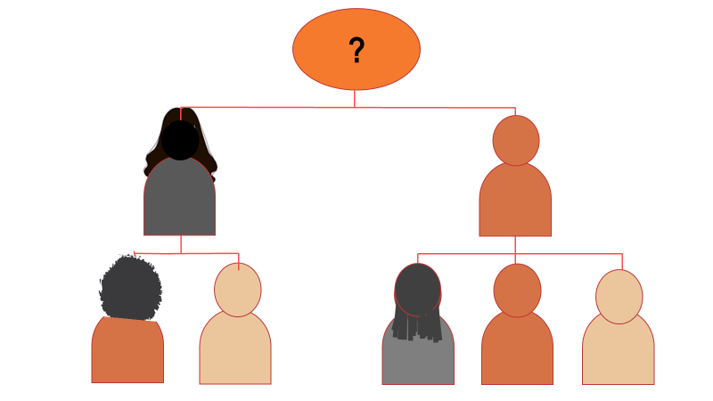
Succession Planning: “More Vital than Ever” –
Polls Answers
Wednesday, June 15, 2022

Slide 2
Experience with Executive Transitions
Poll #1
What types of executive transitions/successions have you experienced or closely observed? Check all that apply.
No experience – 44%
The scheduled departure of the founding chief executive – 19%
The scheduled departure of a chief executive who was not the founder – 13%
A temporary emergency transition – executive returned – 13%
A permanent emergency or unexpected transition – 25%
Termination/firing of a chief executive – 19%
Development of internal staff for possible promotion to chief executive – 31%

Slide 3
Executive Transitions in Your Nonprofit
Poll #2
How long has it been since your nonprofit has had a chief executive transition? Check one.
About to begin or in the middle of one now – 6%
Less than a year – 6%
1-3 years – 18%
4-6 years – 18%
7-10 years – 18%
More than 10 years – 12%
Never – our founding chief executive still runs the organization – 24%

Slide 4
Transition Planning by Your Board of Directors
Poll #3
What succession planning has your Board of Directors done? Check all that apply.
Board has an emergency succession plan – 0%
Board has a succession plan for the scheduled departure of a chief executive – 0%
Some policies in place but not a full succession plan – 18%
No plan, but our Board is good at stepping up when needed – 29%
Preparation of 1 or more senior staff to become chief executive – 12%
No preparations or plans – 47%

